Slide 1


Café Robot Problem: Scenarios
By: Ashraf - 196280

Slide 2
Scenario 1: Deliver Coffee To Dr. Gerard & T.A TokA
Using A* to make the robot “R” traverse the shortest path

Slide 3
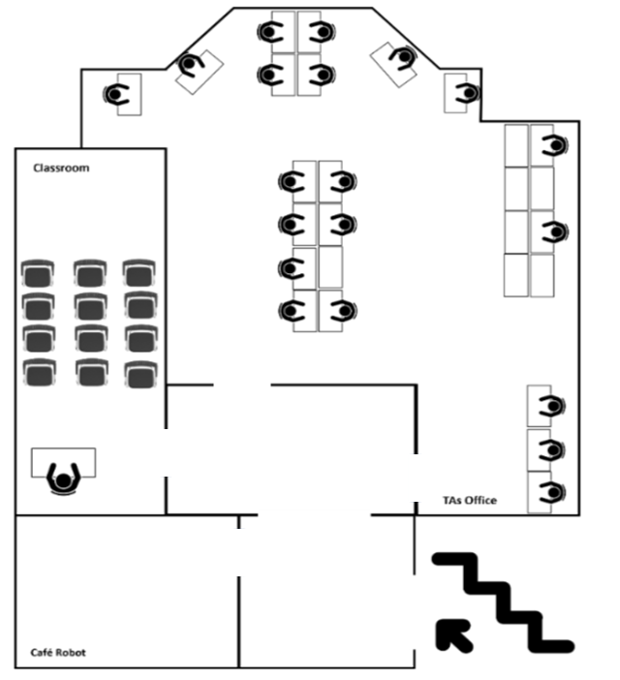


Slide 13


Slide 21


Slide 30


Slide 31
Scenario 2: “R” can’t deliver coffee to T.A Maha
Therefore, for specific staff members, it is allowed for “R” to deliver coffee on the table

Slide 36

T.A Enjy doesn’t want to
be disturbed!

Slide 37

Rewind!

Slide 42
Staff concerns regarding “R” moving through a narrow space
Therefore, for specific staff members, they will have to get the coffee themselves from “R”

Slide 45
T.As Amira and Shehab are afraid “R” will spill the cup in that small space!

Slide 46
Rewind!

